Slide 1


Development Cycle Workflow

Slide 2
Topics Covered
Development Process Workflow
Patch Release Workflow
Support Issues Workflow
Internal Defects Workflow (Found by QA Team)
Release Planning Committee
Roles and Resources
Release Plan Details
Retrospection Meetings and KPIs
Audit Checklist
confidential and for internal use only

Slide 3
AMANDA Development Process Framework
Customer input and business requirements
Work together until feature is complete
Development
UAT (Done by Support)
QA
Plan
Analysis
Design
Development
Testing
Release
Development
Scope
Analysis
Architect/Plan
Build/Test
Verify/Stabilize
Document/Release
Prepare the Priority List (
Define the Scope of the Release (features, bugs)
Analyze Business Requirements
Prepare Test Plan
Prepare Technical Design
Perform Impact Analysis
Build and perform Unit Test
Verify and ensure Stability
Document, Release and Support
Agile Iterative approach and Lean Methodology adopted.
confidential and for internal use only

Slide 4
Planning and Prioritization Phase
Completion of the previous release cycle
Prioritized List
Planning
Key Activities
Define Scope
Prioritize release content
Release Kick-off meeting
Key Artifacts
Prioritized list of Business requirements
Draft Release Plan
confidential and for internal use only

Slide 5
Analysis Phase
Planning Complete
Requirements Review and Test Planning
Analysis Complete
Planning
Analysis
Key Activities
Requirement Analysis and Review
Test planning preparation
High Level Estimation
Key Artifacts
Requirement Document
Approach Document
Draft QA Test Plan
confidential and for internal use only

Slide 6
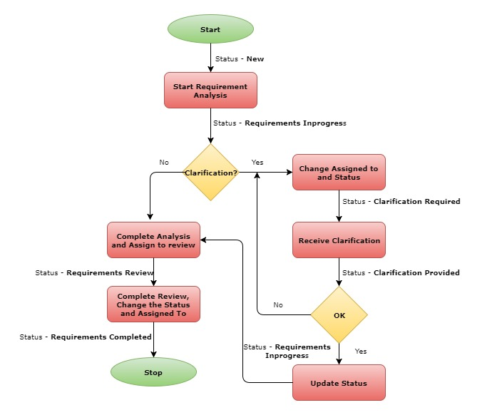
Analysis Phase – Workflow
confidential and for internal use only

Slide 7
Design Phase
Analysis Complete
Technical Design Complete
Design Complete
Planning
Design
Key Activities
Design Analysis and Review
Impact Analysis/Root Cause Analysis
Test Planning Completion and review
Detail level Estimation
Test Cases preparation
Key Artifacts
Impact Analysis/Root Cause Analysis
Estimates
Completed QA Test Plan
Final Release Plan
Draft Test Cases
confidential and for internal use only

Slide 8
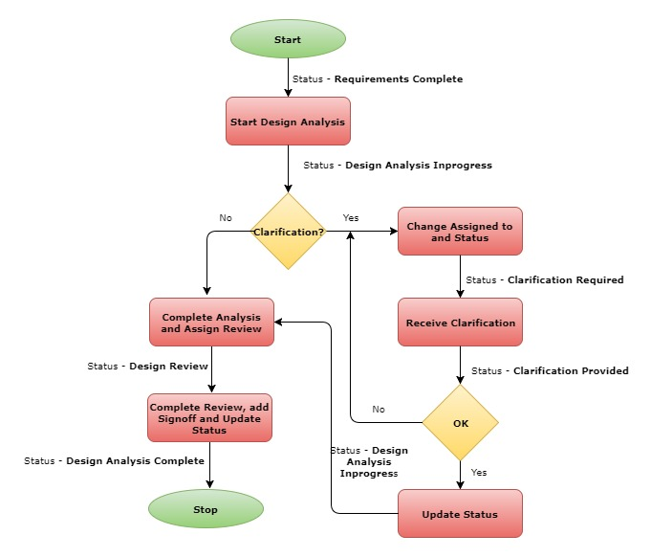
Design Phase – Workflow (Analysis)
Planning
Design
confidential and for internal use only

Slide 9
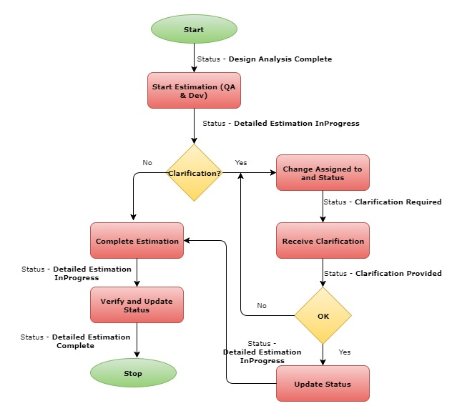
Design Phase – Workflow (Estimation)
Design
confidential and for internal use only

Slide 10
Development Phase
Design Complete
Internal Release
Planning
Development
Daily Integration Builds
Key Activities
Coding and Code Review
Unit Testing
Demos
Test Cases Creation
Key Artifacts
Functional Code
Documentation
Deployment/Release Notes
Code Review Comments
Draft Test Cases
confidential and for internal use only

Slide 11
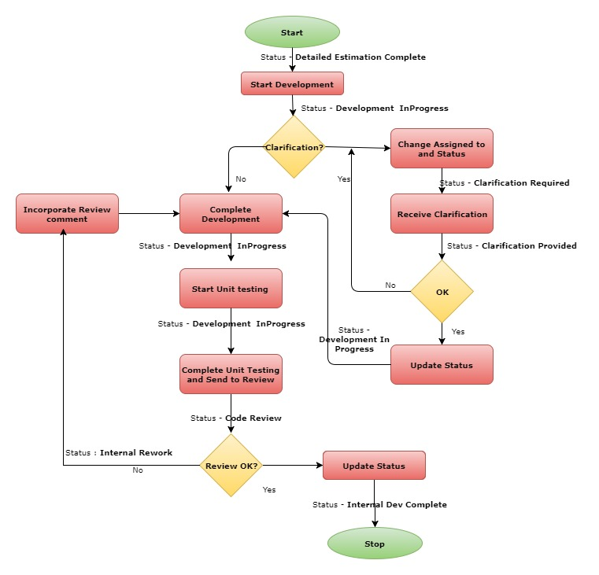
Development Phase – Workflow
confidential and for internal use only

Slide 12
Testing Phase
Development Complete
(UAT/Support Signoff) Regression Testing Complete
QA Signoff
A
B
A
B
B
B
A
A
B
A
B
C
D
E
Planning
Testing
A – Internal Release(s)
B – UAT Feature(s) Testing Complete
C – dB Freeze
D – Code Freeze
E – Customer Notification
Daily Builds
Key Activities
Sanity Testing
System Testing
(Functional and Integration)
Regression Testing
User (Support) Acceptance Testing (UAT)
Performance Testing
Web Content Accessibility Testing (WCAG)
Security Testing
Automation Testing
Quality of AMANDA is ensured with continuous regression testing.
Automation suite will cover the major functional flows of the various modules
Scripts will be executed during the entire release cycle to ensure the stability and identify issues.
* In AMANDA 6 we use QTP and in AMANDA 7 we will be using Selenium
Key Artifacts
Test Data; Test Plan; Test Cases
Automated test scripts
Test Reports
Bug and Status Email
confidential and for internal use only

Slide 13
Release Planning Committee
Release Planning Committee:
Anthony Duong – UAT Issues
Subhash Pandey – Support
Nandini Ganguly – Process/ Product Mgmt.
Sangeet Cherry – UX Advisor
Alan Borris – FOIA Vertical
Prashanjit Choudhury (PC) – Courts Vertical
Hong Dinh – Property Tax Vertical
Sam Kumar – Customer Projects POC
India Team (PM/Dev. Lead/ QA Lead)
Other Ownership:
Anthony Duong – Environment & Quality
Bhuvaneswari Vanarajan – Process
Release Plan/Scope Owner: Subhash Pandey
Note: Same Team will be involved in Retrospection meetings.
confidential and for internal use only

Slide 14
Key Roles and Resource information
 | Delhi | Aspire | ESS | UAT
Project Manager | Neha Gupta, Dharmendra Kumar | Rajesh Paneerselvam | Harekrushna Rath | Anthony Duong, Prashanjit Choudhury, Alan Borris Hong Dinh
Dev. Lead(s) – Tier – 3 (Architect Level) | Santosh Kumar, Ganesh Surisetty | Rajesh Paneerselvam | Antaryami Sahoo
Dev. Lead(s) – Tier – 2 (Senior Level) | Sailendu Mishra, Poonam Singh, Pooja Solanki | Rajesh Paneerselvam, Thirumurugan Pandian, | Nirmal Mandhata, Nibedita Swain,
Dev. Leads – Tier – 1 (Beginners) | Medha Kumari, Jagannath Bahera, Ashwani Kumar | Chandra Narayanan, Ilakkia Keerthana | Anjanamai Pallai, Rasmita Nayak
QA Lead(s) | Prasunjit Bir, Bhuvaneswari Vanarajan | Mathivanan Chellaiah, Mani Bala | Jyotirmaya Das | Sonali Mishra, Aparna Hariharan, George Der
Product Manager | Nandini Ganguly Alan Borris (FOIA) Prashanjit Choudhury (JEMS) | Nandini Ganguly Alan Borris (FOIA) Prashanjit Choudhury (JEMS) | Nandini Ganguly Alan Borris (FOIA) Prashanjit Choudhury (JEMS) | Nandini Ganguly
confidential and for internal use only

Slide 15
Release Types
There are three types of AMANDA releases:
Feature Release
It is a planned release that introduces new functionality, as well as quality improvements.
Patch Release
It is a critical fix that needs planning and must be scheduled. The patches are planned based on Customer demand.
Hot Fix
It is an unplanned and urgent solution (fix) that must be scheduled and implemented immediately.
confidential and for internal use only

Slide 16
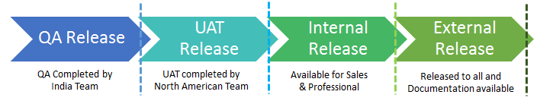
Release Plan
Release plan is based on below four gates
QA Release
UAT Release
Internal Release
External Release
** The 4 stages is a new process that is introduced in July 2017 to get buy in from Professional Services and Sales Team.
** Currently External Release along with the Documentation is given to customers after UAT is completed by North American Support Team. This is so that we do not delay the release for the customer due to the unavailability of the PS/Sales team members to test and provide feedback.
confidential and for internal use only

Slide 17
Release Plan - Activities
Below are the important Activities done by Release planning Committee and coordinated by the Release Plan Owner
Create and Finalize the Release plan
Maintain Release plan - It is based on the following types of Tasks.
Internal issues by QA
UAT Defects
Support Issues
Product Management initiated based on Roadmap
PM initiated Beta Customer reported issues
Tracking Release plan – Project Wall will be used to track the release plan.
Retrospection Meetings
confidential and for internal use only

Slide 18
Release Plan - Key facts
Major Releases will have higher volume compared to Minor and Patch release.
Project Wall – For all releases to track the progress.
Project Wall has the below details
Task Type
iTrack Id
Module
Sub Module
Status
Severity
Assigned to
Planned and Actual QA Date
Planned and Actual UAT Date (Release Date)
confidential and for internal use only

Slide 19
Release Plan - Key facts
Project wall will be Key document in Status meeting.
Development team & QA Team will prepare their own Status report (Daily/Weekly).
India Development team (Development and QA ) progress will be tracked against project wall.
We have some important Dates during our Release cycle. They are,
DCUT Date (Expected Delivery Date to QA) - Development Cut off date is Cut off Date to Complete all Development for the scope listed for that release. As Development is completed it moves to QA for testing
UAT Delivery Date ( Expected Delivery Date to UAT) – Cut off date to complete all QA Testing for the scope listed for that release. Once testing is completed it moves to UAT. We have UAT Delivery date for all iTrack task – This date is updated based on the Dev and QA team Estimation.
Development Phase
Testing Phase
Development
QA UAT
DCUT Date
UAT Delivery Date
** Development, QA and UAT team to work together until the feature is complete.
confidential and for internal use only

Slide 20
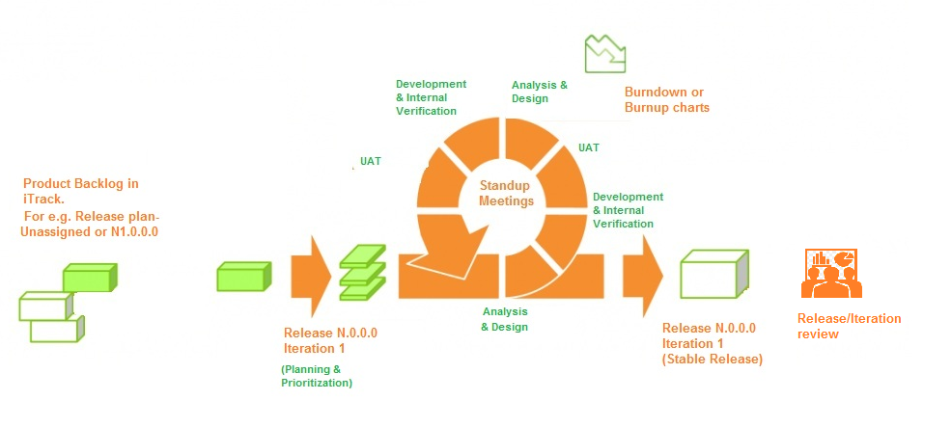
Release plan
confidential and for internal use only

Slide 21
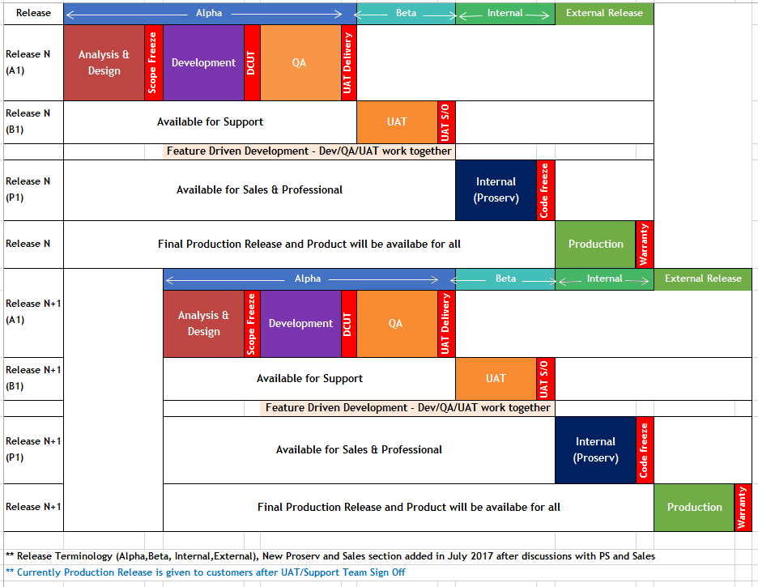
Release plan
confidential and for internal use only

Slide 22
Release specific SVN Branching
The development for the current release always takes place on trunk.
All the development teams work on the trunk and the codes are committed (after code review).
Once all the final UAT passes all tickets for the release, a new branch is created and named as per the naming convention.
The DB scripts and codes are frozen before a few days from release.
All previous branches corresponding to previous releases are supported and the subsequent minor & patch releases are done from them.
In order to ensure stability of the branch regression testing is carried out by the internal QA (of dev teams) followed by UAT (as mentioned in Support ticket process).
All SVN branch are synced to automated build process .
confidential and for internal use only

Slide 23
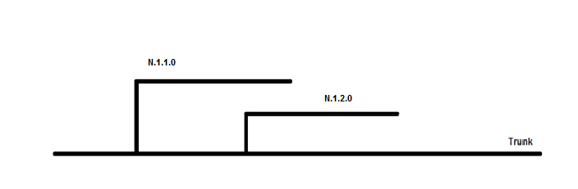
Release specific SVN Branching
Here N.1.1.0 & N.1.2.0 denotes the branches where
N.0.0.0- Major Release (New SVN branch is created)
N.1.0.0- Next major release (New SVN branch is created)
N.1.1.0- Next minor release (New SVN branch is created)
N.1.1.1- Patch releases (New SVN branch is not created and the release is given from the previous minor branch):
confidential and for internal use only

Slide 24
Retrospective Meetings
Retrospective – A Special meeting (s) at the end of production release to look back and examine the way we work, analyze and identify the improvement plan to deliver better product in future release.
Team: Release Planning Committee
Inputs of Retrospective Meeting:
Project Dashboard is the input of Retrospective meeting. Project Dashboard will have inputs from following Reports and Results.
Burndown and Burn up Charts created by various departments
Metrics Calculated
Root Cause Reports
Audit and Review Results
confidential and for internal use only

Slide 25
Retrospective Meetings
Activities :
Collect all the required data before Meeting (upcoming slides will have detailed information)
Discuss - What Went Well
Discuss – What is not going Well
Discuss – Improvement plans
Set Priorities to improvement plan
Assign Responsibilities
Close the meeting
confidential and for internal use only

Slide 26
Retrospective Meetings – Burn up Charts
BurnupChart – Development team - It will be created using the Total Number of tasks planned and Completed tasks per week(Closed). This gives an actual forecast of progress of release items.
confidential and for internal use only

Slide 27
Retrospective Meetings – Burn up Charts
Burn up Chart – QA - It will be created using the Execution Percentage and Pass Percentage. This gives an actual forecast of Project Health.
confidential and for internal use only

Slide 28
Retrospective Meetings
Effort Variation
Is used to calculate the deviation of the actual effort expended as against the Estimated effort.
This metric is the difference between Estimated and Actual effort as compared against the Estimated Effort.
Input Parameters :
Actual Effort
Estimated Effort
Formula :
Effort Variation in % = ((Actual Effort - Estimated Effort)/ (Estimated Effort) )*100
confidential and for internal use only

Slide 29
Retrospective Meetings – KPI Metrics
Test Effectiveness
The objective of this metrics is to determine the testing efficiency. .
This metrics shows the efficiency of removing defects by internal Testing before delivering to UAT/customer.
Input Parameters :
Total Number of Valid Defects Found by Testing Team
Total Number of Valid Defects Found by UAT/Customer
Formula :
Over all Valid Defect = Total Number of Defect Found by testing team + Total number of Valid Defect found by UAT/Customer
Test Effectiveness % = (Total Number of Valid Defects Found by Testing Team / Overall Valid Defect) * 100
confidential and for internal use only

Slide 30
Retrospective Meetings – KPI Metrics
Test Execution Coverage
This metrics is useful to measure the number of test cases executed against the plan .
Input Parameters :
Total Number of Testcases planned to execute
Total Number of Testcases actually executed
Formula :
Test Execution Coverage in % = (Total Number of Testcases actually executed
/Total Number of Testcases planned to execute) * 100
confidential and for internal use only

Slide 31
Retrospective Meetings – KPI Metrics
Error Discovery Rate
It is defined as ratio of defects per test cases .
The aim of this metrics is to determine the effectiveness of the test cases.
Input Parameters :
Total Number of Defects Found
Total Number of Testcases Executed
Formula :
Error Discover Rate = (Total Number of Defects Found
/Total Number of Testcases Executed) * 100
confidential and for internal use only

Slide 32
Retrospective Meetings – KPI Metrics
Defect Leakage to UAT
This metric gives a very good indication of the review / testing process within a testing environment. It determines the % of defect leaked to the UAT Environment
Input Parameters :
Total Number of Valid Defects found by testing team
Total Number of valid defects found by UAT
Formula :
Over all Valid Defect = Total Number of Valid Defect Found by testing team + Total number of Valid Defect found by UAT
Defect Leakage = (Total Number of Valid Defects Found by UAT / Overall Valid Defect) * 100
confidential and for internal use only

Slide 33
Retrospective Meetings – KPI Metrics
Defect Leakage to Customer
This metric gives a very good indication of the review / testing process witin testing environment. It determines the % of defect leaked to the Production Environment
Input Parameters :
Total Number of Valid Defects found by testing & UAT team
Total Number of valid defects found by Customer
Formula :
Over all Valid Defect = Total Number of Valid Defect Found by testing team + Total number of Valid Defect found by UAT/Customer + Total number of Valid defect found by Customer
Defect Leakage = (Total Number of Valid Defects Found by Customer / Overall Valid Defect) * 100
confidential and for internal use only

Slide 34
Retrospective Meetings – Metrics Dashboard
confidential and for internal use only

Slide 35
Root Cause Analysis
confidential and for internal use only

Slide 36
Audit Checklist
confidential and for internal use only

Slide 37
Thank You
Product Development Team
T: 647 460 0693

